Slide 1
Email performance
Demetra Zoulfou ,MsC Applied Geoinformatics

Slide 2
Email campaigns analysis & metrics
Email performance
Optimal Acquisition Email Metrics
Optimal Outcomes Email Metrics
Optimal (Website) Behavior Email Metric

Slide 3
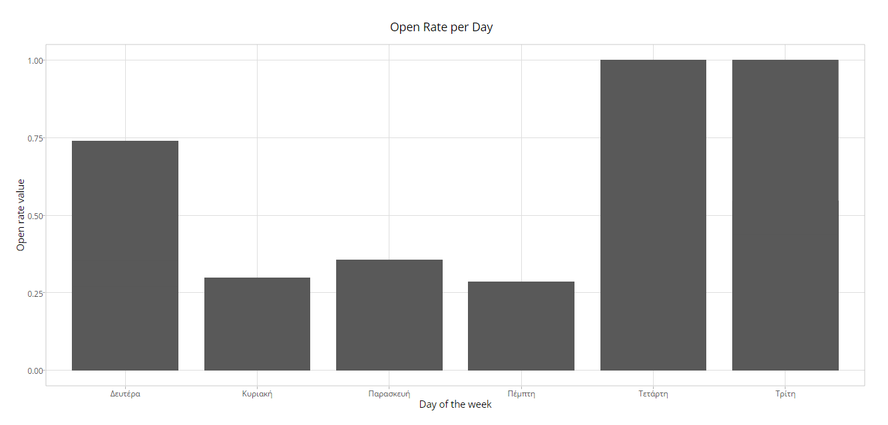
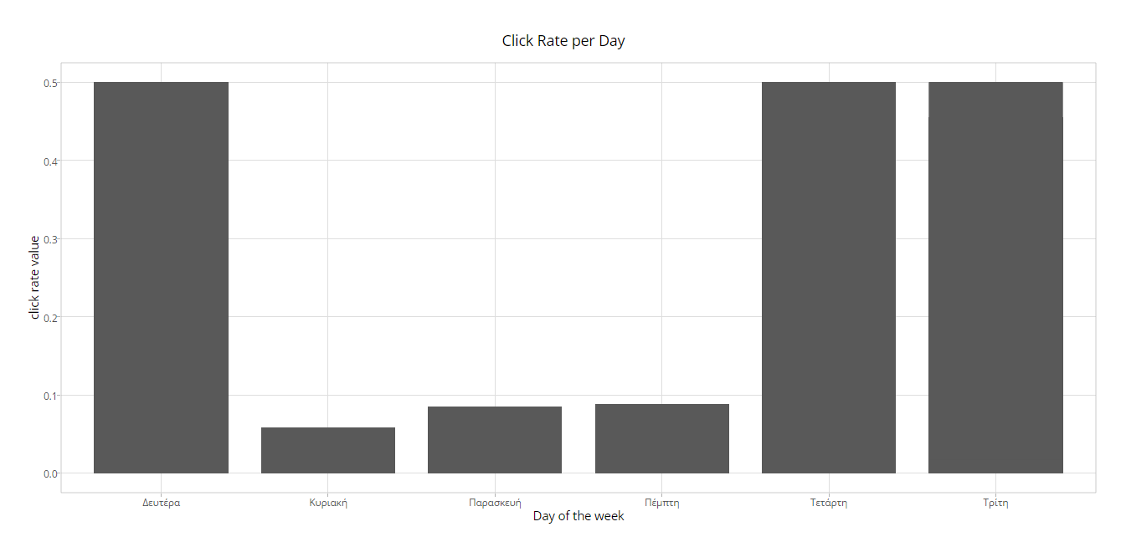
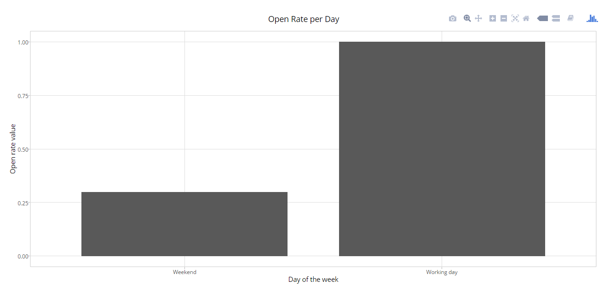
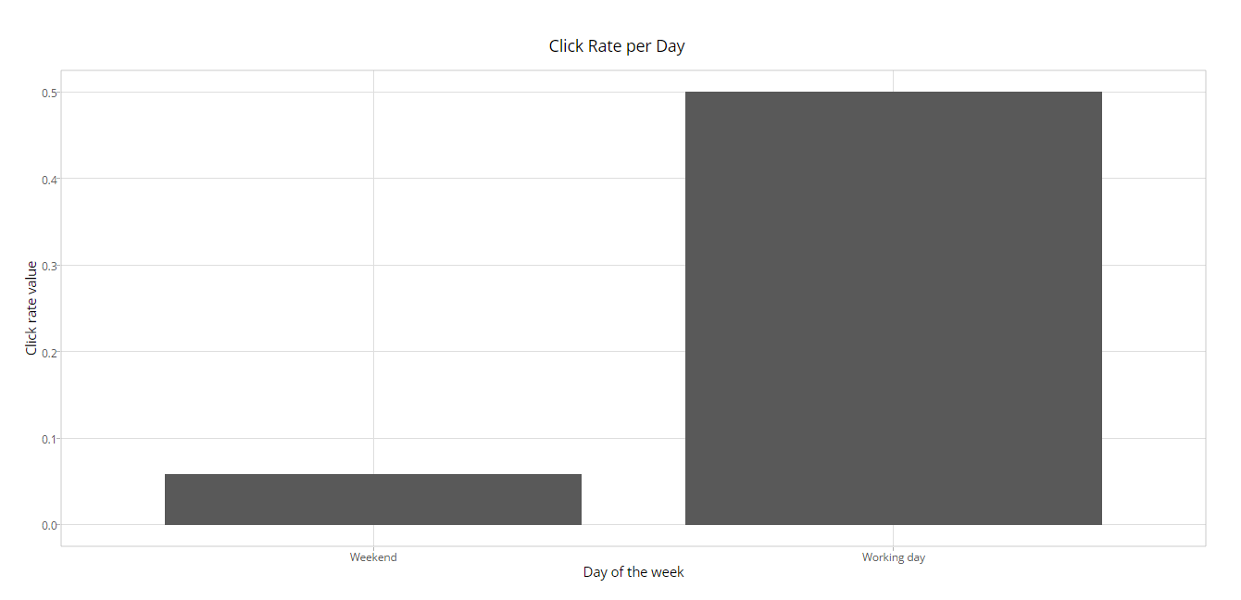
Looks like customers prefer to open or click emails on specific days…

Slide 4
Optimal Acquisition Email Metrics
Open rate
For understanding how effective subject line in your email campaign is!
Click-to-deliver rate or Clickthrough rate (CTDR)
You can learn whether text messages or messages with images get a higher CTDR
Subscriber retention rate
measuring both the technical effectiveness of your email campaigns over time (reducing bounce backs) and the relevance of your messages and the targeting of the same (reducing unsubscribes)

Slide 5
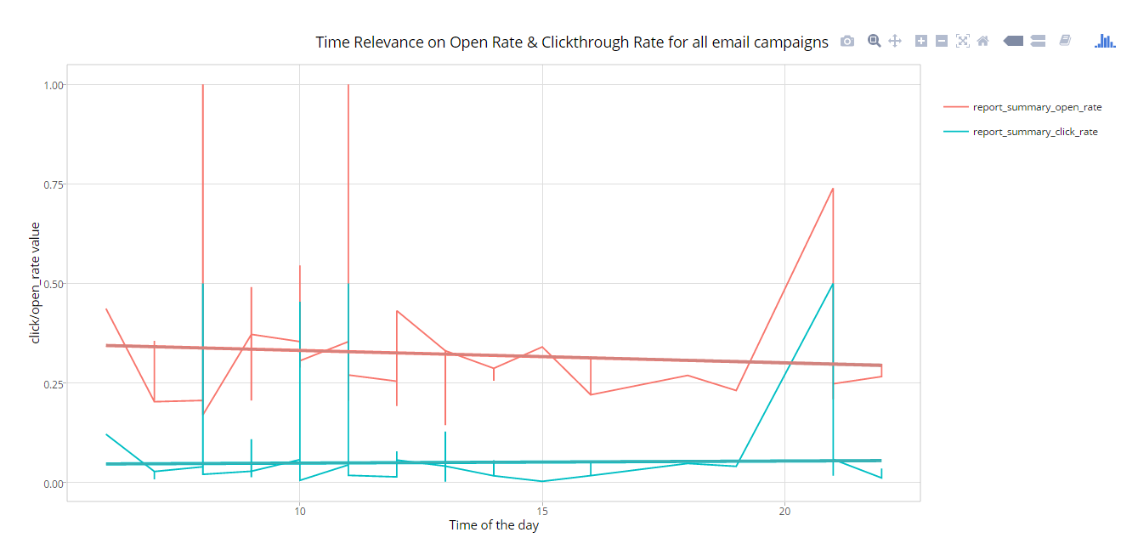
Open rate/Click-to-deliver rate (all email campaigns)

Slide 6
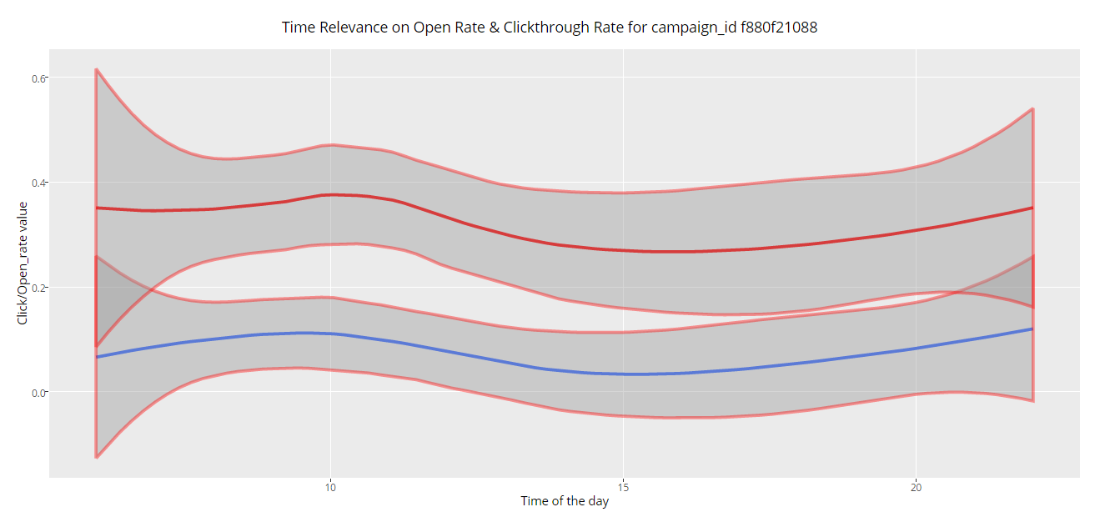
Open rate/Click-to-deliver rate (per email campaign)

Slide 7
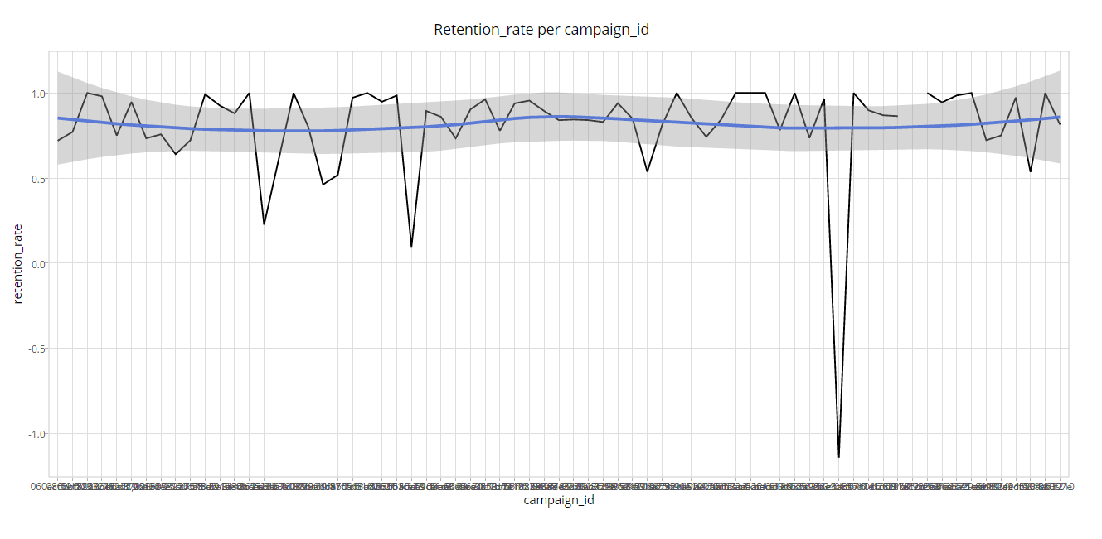
Subscriber retention rate

Slide 8
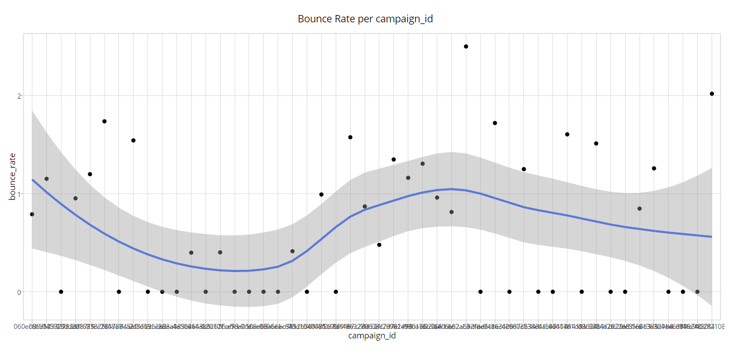
Optimal (Website) Behavior Email Metric Bounce Rate
Improvement Pages and calls to action you should test, and content that fails to deliver.
You’re still not safe even if this metric is 0%, but now you are in the game to get valuable business outcomes.

Slide 9
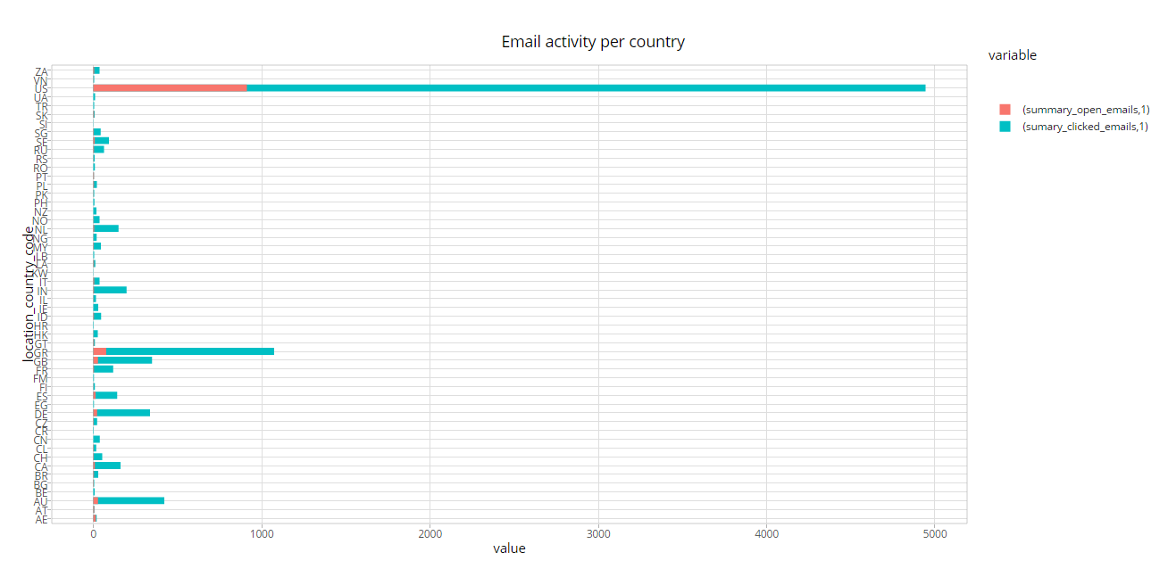
Location analysis
Best “customers-users” from USA & Greece

Slide 10
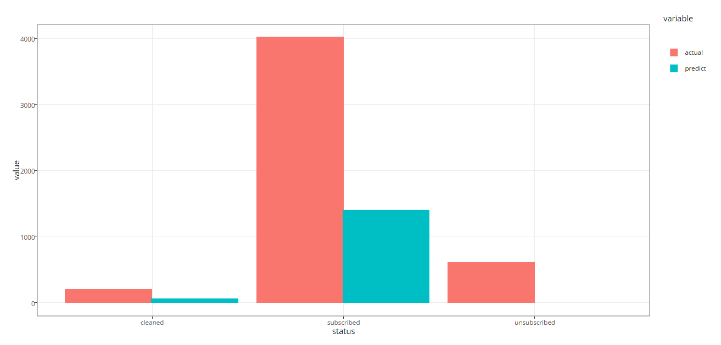
Random Forests Can we predict the status of a user from email avtivity?

Slide 11
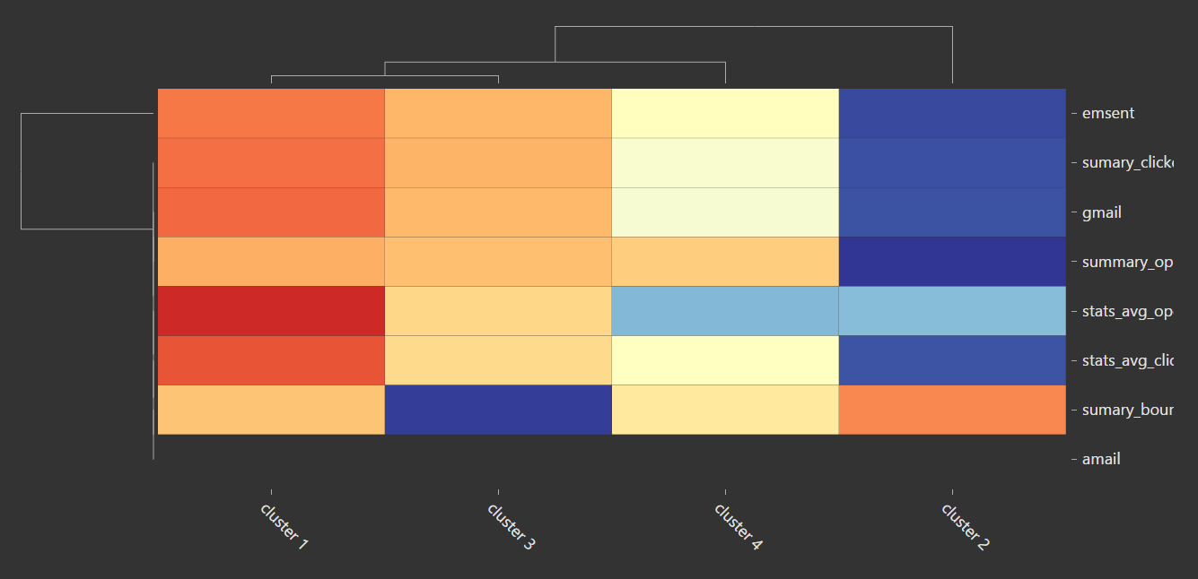
Principal Component Analysis (PCA) Can we cluster users based on their activity ?

Slide 12
Optimal Outcomes Email Metrics?
Micro Conversion Rate
Average Economic Value per Email Sent
Profitability
Achievable when we’ll be able to know the content of each email campaign

Slide 13
Next steps
Run model on more test sets
Train model on more data
Try reducing number of parameters
Examine large error outliers
Compare with simple models
Run email campaign with control and model results for final judgement

Slide 14
Thank you!

